Slide 1
Measures of Dispersion (Variation)

Slide 2
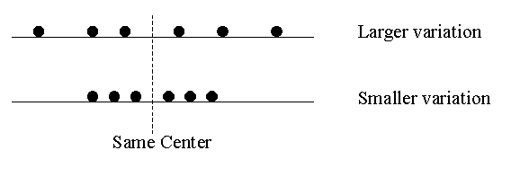
Measures of Dispersion (Variation)
The variation or dispersion in a set of values refers to how spread out the values are from each other.
The variation is small when the values are close together.
There is no variation if the values are the same.

Slide 3
Measures of Dispersion
While measures of central tendency indicate what value of a variable is “average” or “central value” in a set of data, measures of dispersion (or variability or spread) indicate the extent to which the observed values are “spread out” around that center — how “far apart” observed values typically are from each other and therefore from some average value (in particular, the mean).
The measure of location do not give an adequate description of data. We need to know how the observations spread out from the average.
A measure of dispersion provides a summary statistic that indicates the magnitude of such dispersion and, like a measure of central tendency, is a univariate statistic.

Slide 4
Measures of Dispersion
  Measures of dispersion are descriptive statistics that describe how similar a set of scores are to each other.
    if all cases have identical observed values (and thereby are also identical to [any] average value), dispersion is zero.
    if most cases have observed values that are quite “close together” (and thereby are also quite “close” to the average value), dispersion is low (but greater than zero)
    if many cases have observed values that are quite “far away” from many others (or from the average value), dispersion is high.

Slide 5
Importance of the Magnitude Dispersion Around the Average
Dispersion around the mean test score.
Baltimore and Seattle have about the same mean daily temperature (about 65 degrees) but very different dispersions around that mean.
Dispersion (Inequality) around average household income.

Slide 6
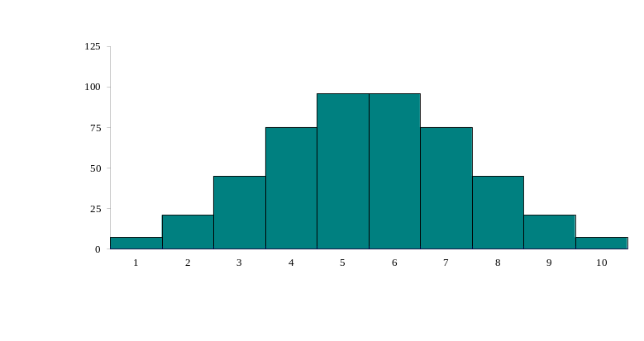
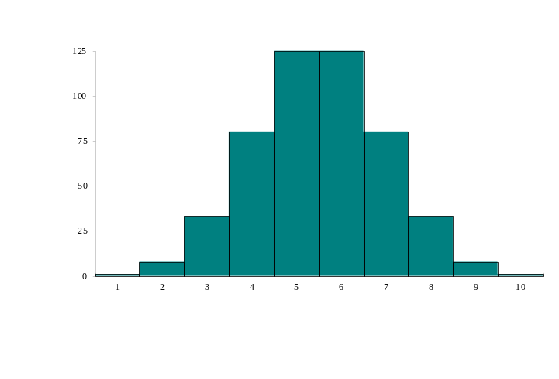
Measures of Dispersion
Which of the distributions of scores has the larger dispersion?
The upper distribution has more dispersion because the scores are more spread out
  That is, they are less similar to each other

Slide 7
Measures of Dispersion
There are three main measures of dispersion:
  The range
  Variance / standard deviation

Slide 8
Measures of Dispersion
There are three main measures of dispersion:
  The range
  Variance / standard deviation

Slide 9
The Range
The range is defined as the difference between the largest score in the set of data and the smallest score in the set of data, X_{L} - X_{S}
What is the range of the following data:
4 8 1 6 6 2 9 3 6 9
The largest score (X_{L}) is 9; the smallest score (X_{S}) is 1; the range is X_{L} - X_{S} = 9 - 1 = 8

Slide 10
When To Use the Range
The range is used when
  you have ordinal data or
  you are presenting your results to people with little or no knowledge of statistics
The range is rarely used in scientific work as it is fairly insensitive
  It depends on only two scores in the set of data, X_{L} and X_{S}
  Two very different sets of data can have the same range:
  1 1 1 1 9 vs 1 3 5 7 9

Slide 11
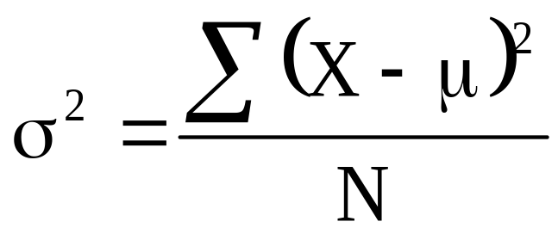
Variance
Variance is defined as the average of the square deviations from the mean:
Population Variance

Slide 12
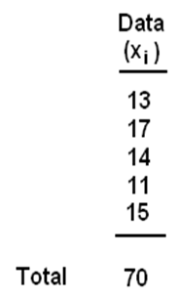
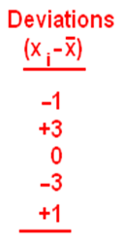
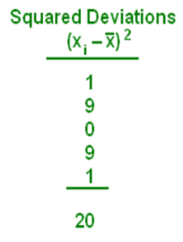


The Variance

Slide 13
What Does the Variance Formula Mean?
First, it says to subtract the mean from each of the scores
  This difference is called a deviate or a deviation score
  The deviate tells us how far a given score is from the typical, or average, score
  Thus, the deviate is a measure of dispersion for a given score

Slide 14
What Does the Variance Formula Mean?
The variance is a measure of the average squared deviation from the mean
  The larger the variance is, the more the scores deviate, on average, away from the mean
  The smaller the variance is, the less the scores deviate, on average, from the mean

Slide 15
Standard Deviation
When the deviate scores are squared in variance, their unit of measure is squared as well
  E.g. If people’s weights are measured in pounds, then the variance of the weights would be expressed in pounds² (or squared pounds)
Since squared units of measure are often awkward to deal with, the square root of variance is often used instead
  The standard deviation is the square root of variance

Slide 16
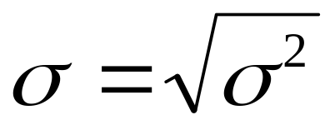

Standard Deviation
Population Standard Deviation
Standard deviation = √variance
Variance = (standard deviation)²

Slide 17

The Standard Deviation

Slide 18
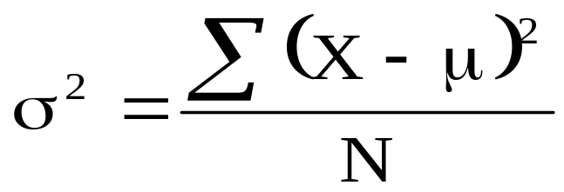

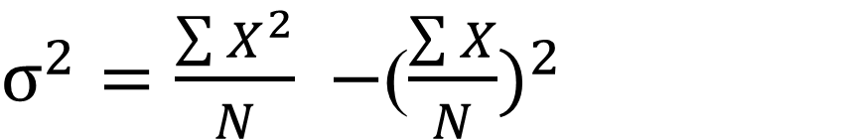
Equivalent formula
Population Variance

Slide 19
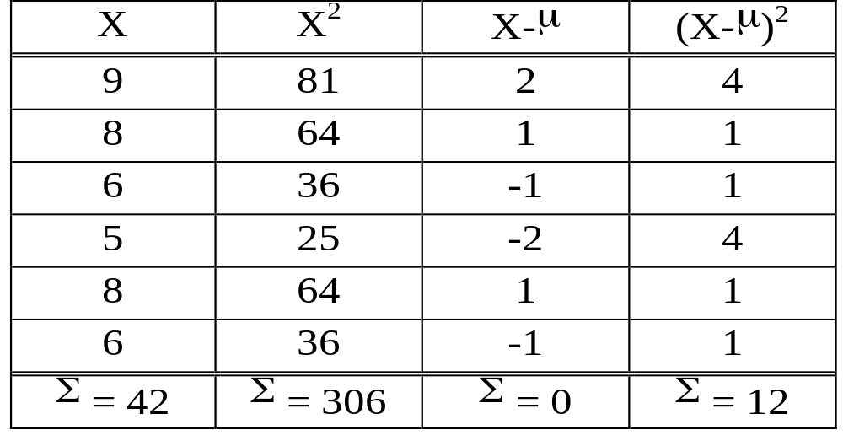
Variance and Standard Deviation
Find the variance and standard deviation of
9, 8, 6, 5, 8 6

Slide 20
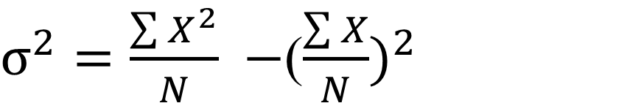
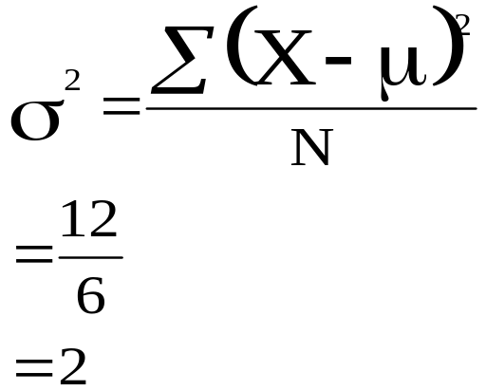
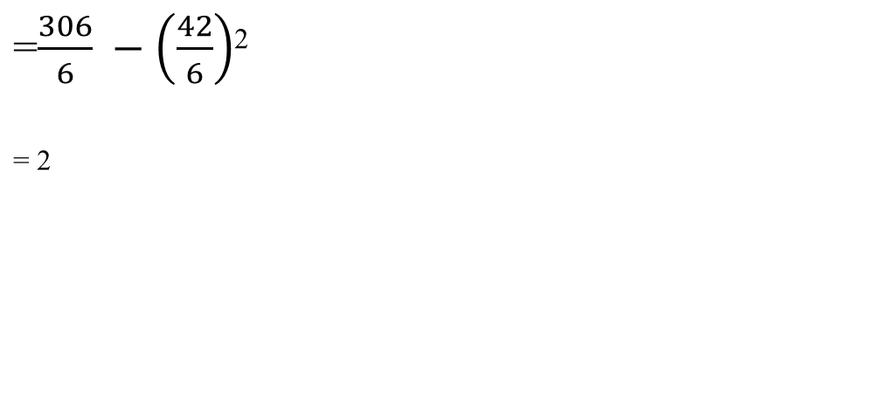

Variance and Standard Deviation

Slide 21
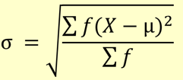


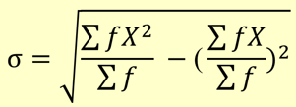

Population Variance and Standard Deviation for grouped data
Population Variance
Population Standard Deviation

Slide 22
Find the variance and standard deviation
Class Interval | Frequency (f)
0 - 10 | 9
10 - 20 | 13
20 - 30 | 8
30 - 40 | 15
40 - 50 | 10

Slide 23
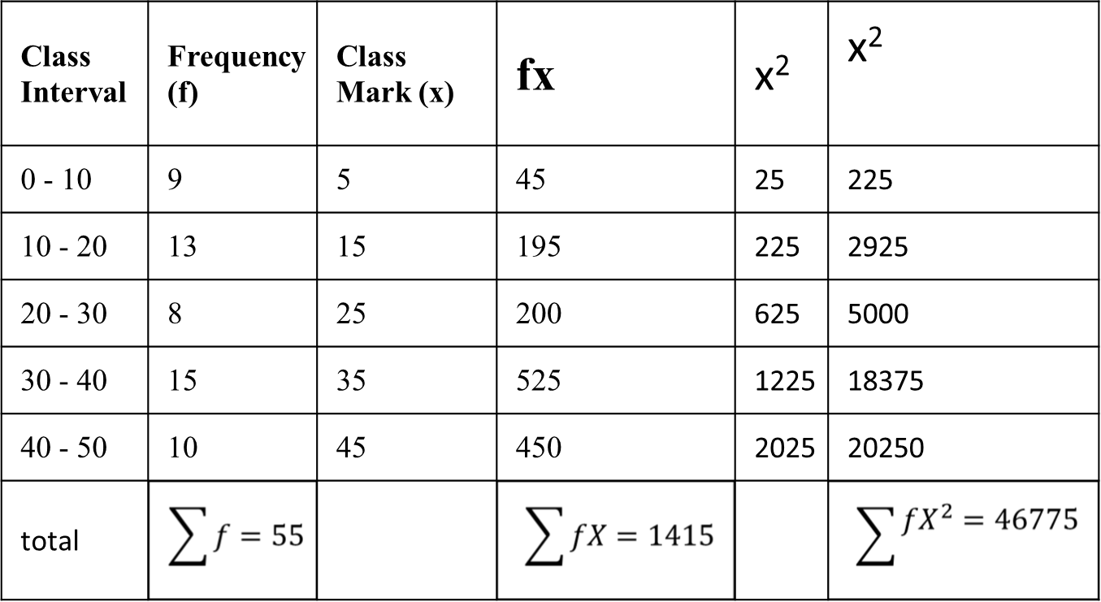
Find the variance and standard deviation

Slide 24
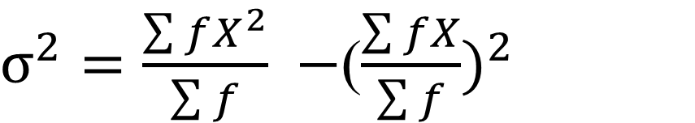
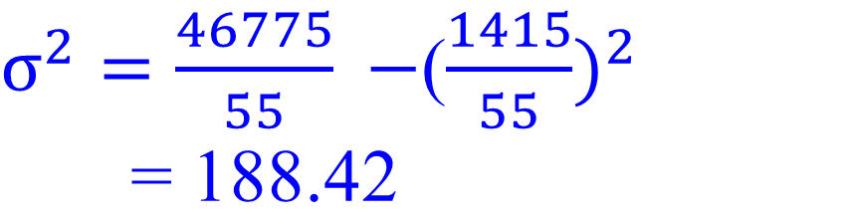
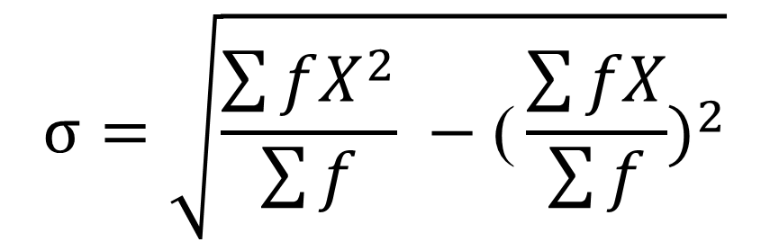

Find the variance and standard deviation

Slide 25

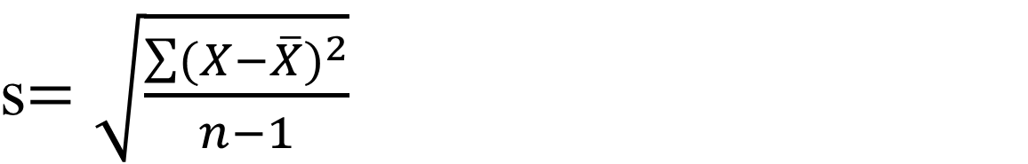

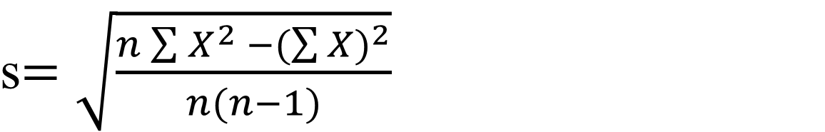
Sample Variance and Standard Deviation for ungrouped data
Sample Variance
Sample Standard Deviation

Slide 26

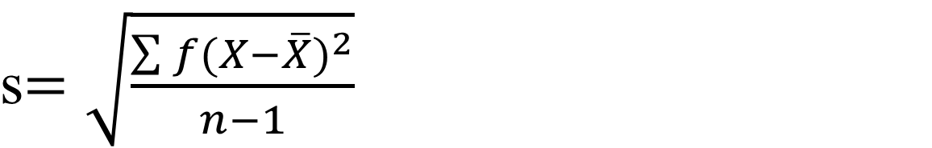
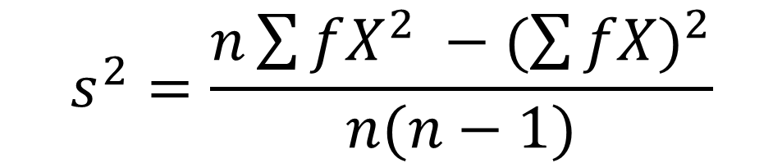
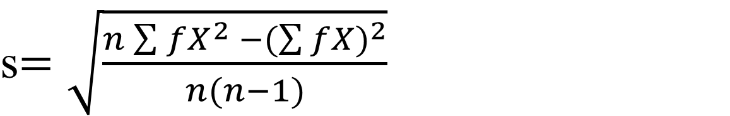

Sample Variance and Standard Deviation for grouped data
Sample Variance
Sample Standard Deviation

Slide 27
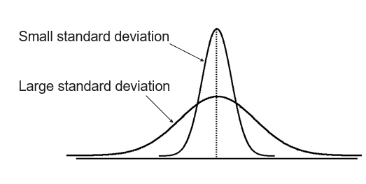
Measuring Variation

Slide 28
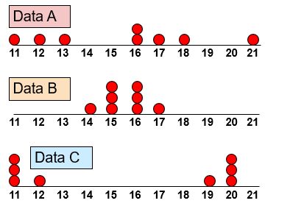
Comparing Standard Deviation

Slide 29
Find the sample variance and standard deviation
Compute the sample variance and standard deviation for the marks obtained in test by 36 students
Marks | Frequency (f)
10 - 14 | 5
15 - 19 | 10
20 - 24 | 6
25 - 29 | 8
30 - 34 | 7

Slide 30
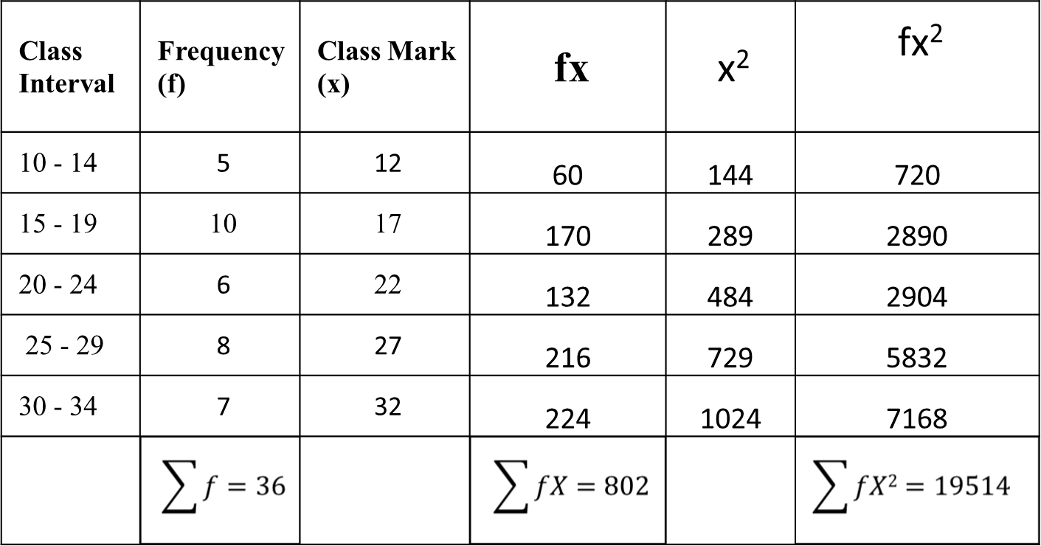
Find the sample variance and standard deviation

Slide 31
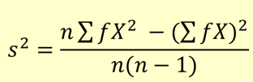

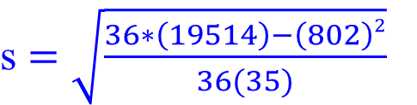
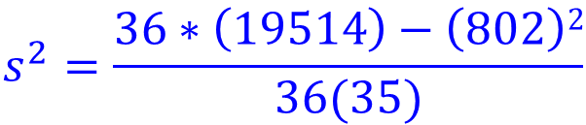

Sample Variance and Standard Deviation for grouped data
Sample Variance
Sample Standard Deviation

Slide 32
Coefficient of Variation
The variance and the standard deviation are useful as measures of variation of the values of a single variable for a single population (or sample).
If we want to compare the variation of two variables we cannot use the variance or the standard deviation because:
  The variables might have different units.
  The variables might have different means.

Slide 33
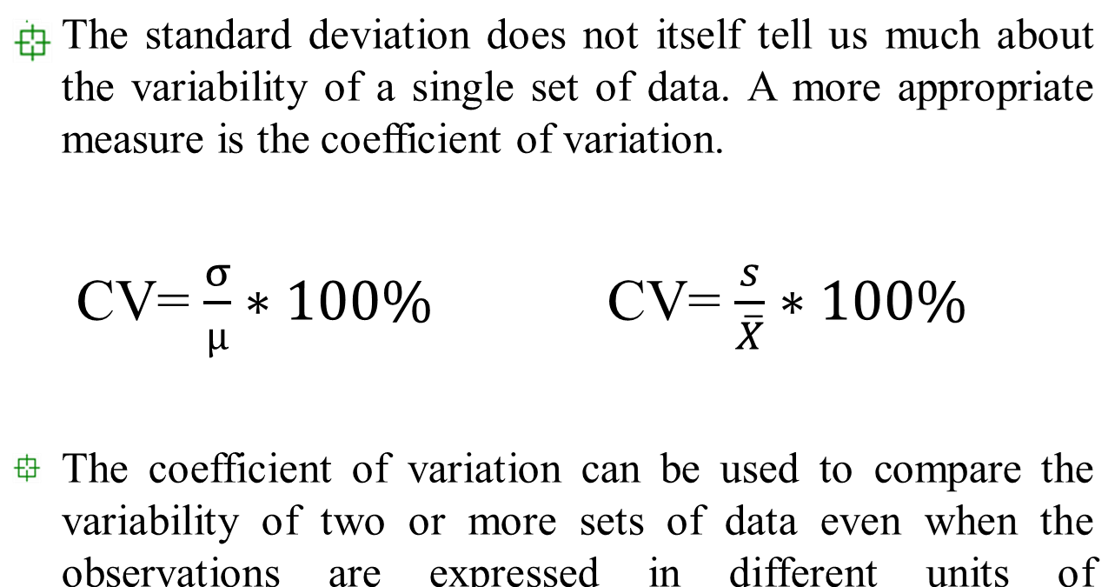
Coefficient of Variation

Slide 34
Chebyshev’s Theorem
The concept of data spread about the mean can be expressed quite generally for all data distributions (skewed, symmetric, or other shapes) by using the remarkable theorem of Chebyshev.
Chebyshev’s theorem is a fundamental concept in statistics that allows us to determine the probability of data values falling within a certain range defined by mean and standard deviation.

Slide 35
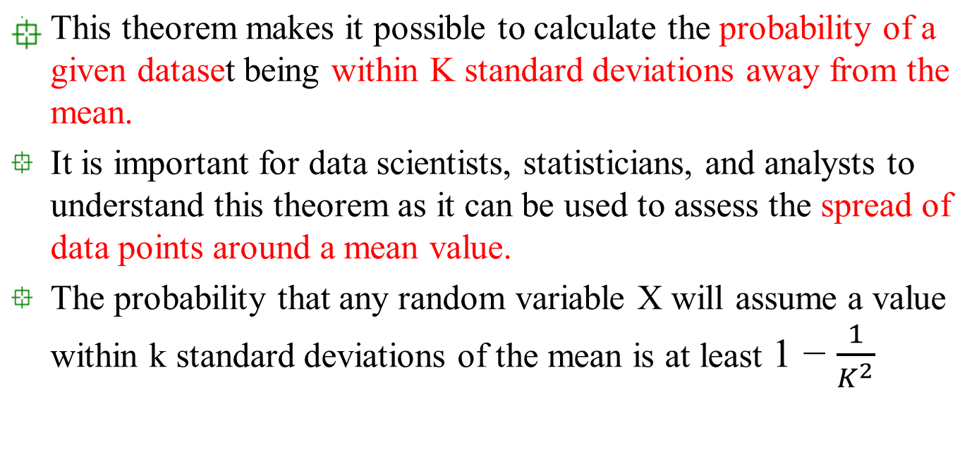

Chebyshev’s Theorem

Slide 36
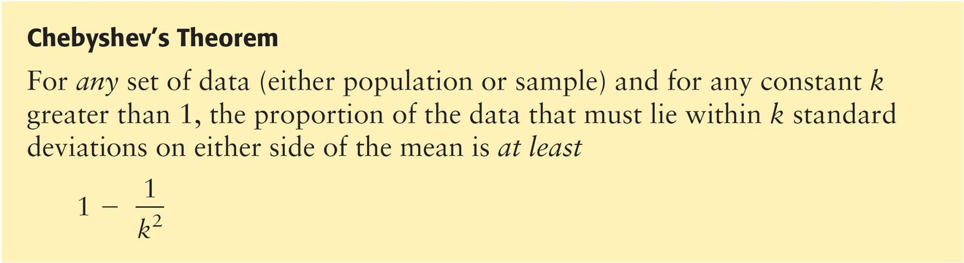
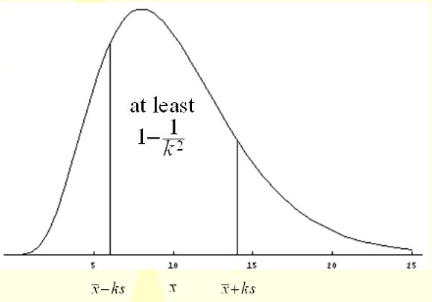

Slide 37
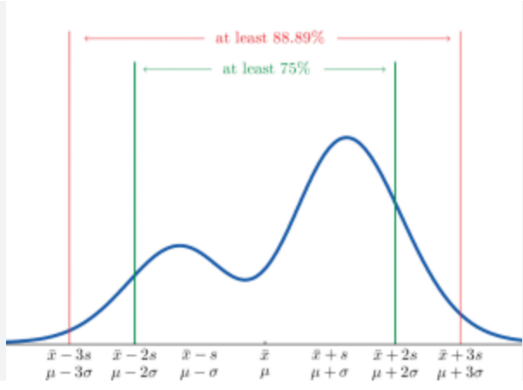
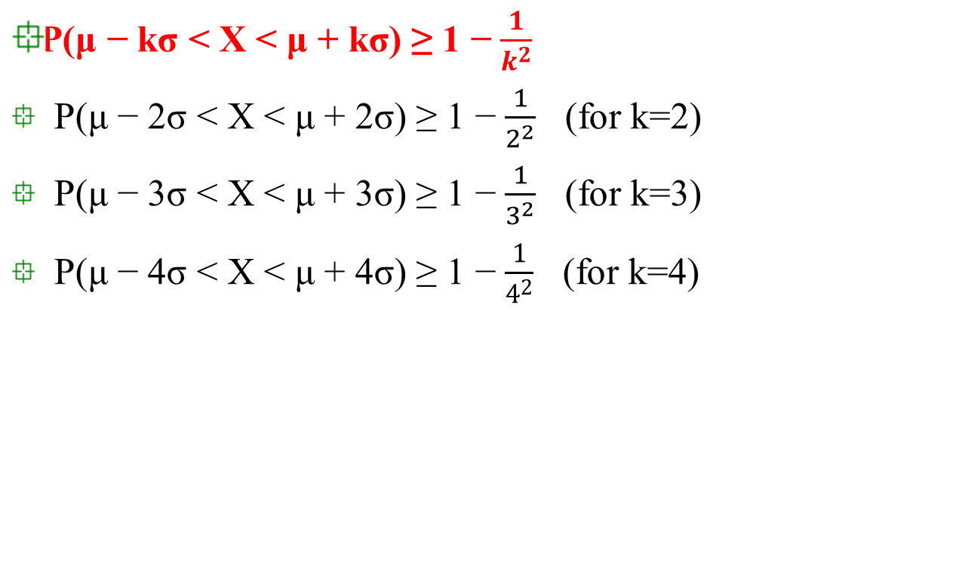
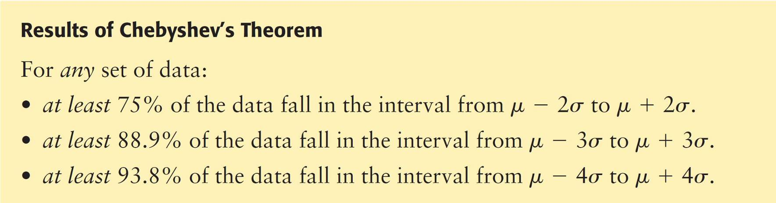
Chebyshev’s Theorem

Slide 38
Chebyshev’s Theorem
Chebyshev’s theorem refers to the minimum percentage of data that must fall within the specified number of standard deviations of the mean.
If the distribution is bell-shaped, an even greater percentage of data will fall into the specified intervals.

Slide 39
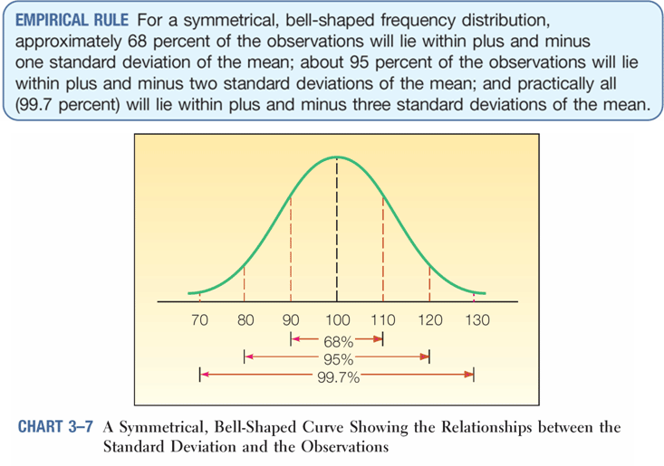

Slide 40
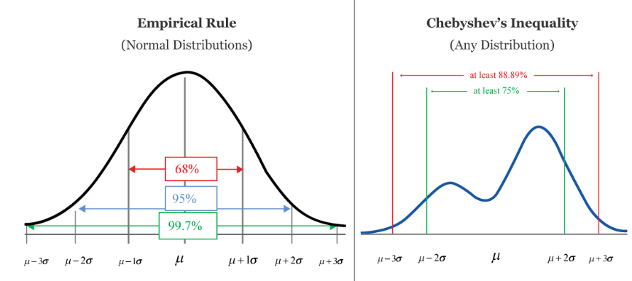

Slide 41
EXAMPLE
Students Who Care is a student volunteer program in which college students donate work time to various community projects such as planting trees.
Professor Gill is the faculty sponsor for this student volunteer program. For several years, Dr. Gill has kept a careful record of x = total number of work hours volunteered by a student in the program each semester.
For a random sample of students in the program, the mean number of hours was x = 29.1 hours each semester, with a standard deviation s = 1.7 of hours each semester.
Find an interval A to B for the number of hours volunteered into which at least 75% of the students in this program would fit.

Slide 42
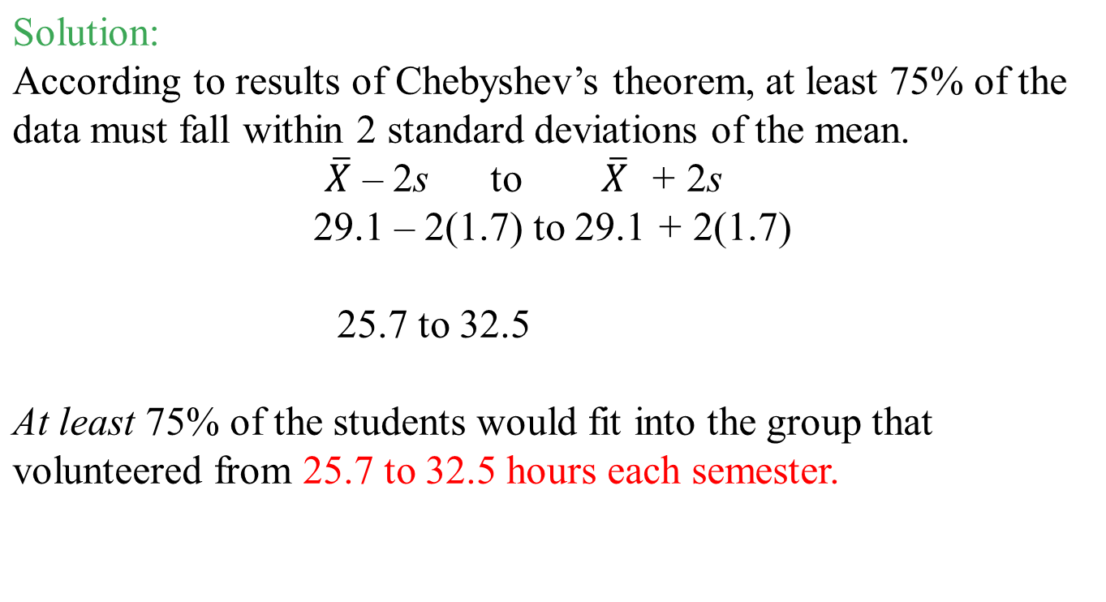
EXAMPLE

Slide 43
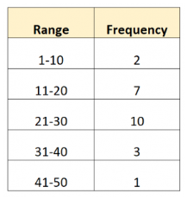
Assignment
Compute the population mean, variance and standard deviation for the data given below

Slide 44
Assignment
Problem 1 : Wages (in Rs) paid to workers of an organization are given below. Calculate the sample mean, variance, standard deviation and coefficient of variation.
Problem 2 : Weekly demand for marine fish (in kg) (x) for 100 families is given below. Calculate the sample mean, variance, standard deviation and coefficient of variation.
Wages ( C.I.) | 40-60 | 60-80 | 80-100 | 100-120 | 120-140 | 140-160
No.of workers (freq) | 50 | 80 | 30 | 20 | 50 | 20
X | 1 | 2 | 3 | 4 | 5 | Total
No. of Families (freq) | 20 | 50 | 20 | 5 | 5 | 100

Slide 45
Assignment
1.8
1.10
The time taken (in minutes) to complete a homework by 8 students in a day are given by 38, 40, 47, 44, 46, 43, 49, 53. Find the coefficient of variation.
The total marks scored by two students Waseem and Faisal in 5 subjects are 460 and 480 with standard deviation 4.6 and 2.4 respectively. Who is more consistent in performance?

Slide 46
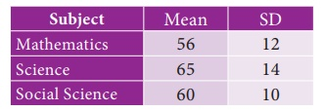
Assignment
The mean and standard deviation of marks obtained by 40
students of a class in three subjects Mathematics, Science and
Social Science are given below.
Which of the three subjects shows highest variation and which shows lowest variation in marks?

